Slide 1
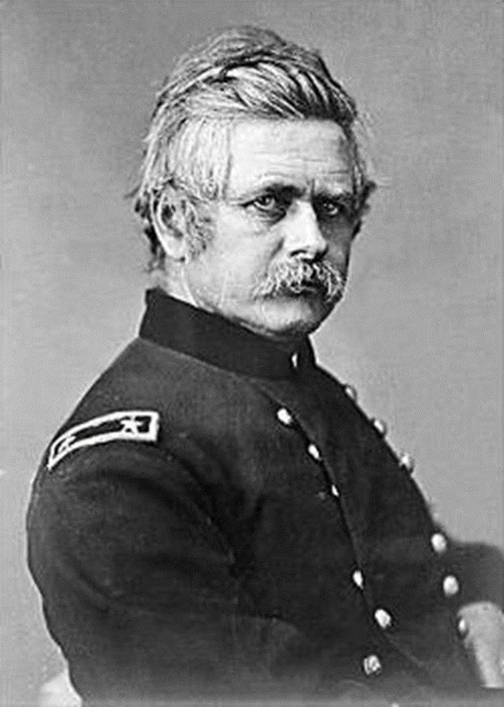
Edward Otho Cresap Ord Major General, U.S. Army 1818-1888
By Mike Harkleroad
June 30, 2018

Slide 2
Brief History of E.O.C. Ord
Edward Otho Cresap Ord: 18 October 1818 (Cumberland, MD) – 22 July 1883 (Havana, Cuba) was an American engineer and United States Army officer who saw action in the Seminole War, the Indian Wars, and the American Civil War. He commanded an army during the final days of the Civil War, and was instrumental in forcing the surrender of Confederate General Robert E. Lee. Fluent in Spanish. He died in Havana, Cuba of Yellow Fever.

Slide 3
Family Tree
#1 Thomas Cresap (1694-1787)
#2 Daniel Cresap (1728-1798)
#17 Robert Cresap (1767-1827) #12 Daniel Cresap Jr. (1753-1794)
#88 Eusebius Cresap (1807-1878) #42 Rebecca Ruth Cresap (1794-1860)
m. James Ord (1786-1873) in 1814
#491 Robert V. Cresap (1836-1911) #235 Edward Otho Cresap Ord (1818-1883)
m. Mary M. Thompson (1834-1894) in 1854
#1484 Edward E. Cresap (1876-1959)
#3264 John Cresap (1901-1992)
#5547 Catherine (Cresap) Harkleroad (1937-2008)
#8463 Michael Harkleroad (1961- present)

Slide 4
Lt. James Ord is assigned to recruiting duty in Cumberland, MD where he meets, courts, and marries Rebecca Ruth Cresap. He is a Catholic and she a Protestant.
Edward Otho Cresap Ord is their third child. (18 October1818). The name Otho comes from Otho Williams, a lifelong friend of Rebecca’s father Daniel Cresap Jr. Daniel and Otho served together in the Revolutionary War. Daniel names his first son after Otho – Edward Otho Cresap – Rebecca’s older brother. He dies in 1817. Rebecca names her son after him – Edward Otho Cresap Ord.

Slide 5
General EOC Ord
1818 - Born at Faw’s tavern, Green St, Cumberland, Maryland
Family stays in Cumberland until 1819 when they move to D.C. where James Ord becomes a minor gov’t official and later a magistrate.
Young EOC is described as having eccentric habits and doing things his own way, lots of energy, eager for adventure and action, aggressive when needed and courageous to the point of foolhardiness. Strong and agile and had a talent for mathematics.
He is stirred by the Cresap heritage on the frontier and on the battlefield.

Slide 7
1835-39 Cadet, U.S. Military Academy
Earns an appt to the USMA (West Point) at age 16.
At USMA Ord is classmates with future Civil War Generals WT Sherman, George Thomas, Richard Ewell, Don Carlos Buell, PGT Beauregard, Henry Halleck, Braxton Bragg, Joseph Hooker, and James Longstreet.
Course of study included math, ethics, engineering, natural and experimental philosophy, tactics, artillery, French, drawing, chemistry and minerology, sword exercise, and astronomy.
Later he was critical of USMA for lack of practical experience, called it eminently theoretical.
Graduates in 1839 #227 of 231.

Slide 8
1839, June – Commissioned a 2nd Lt., 3rd Artillery
1839-42 – Florida wars against Seminole Indians
1841, July 1 – 1st Lt., 3rd Artillery
1842-44 – Ft. Macon, North Carolina
1845-46 – Coast Survey Office, Wash, D.C.
1846 – Recruiting Service, Cumberland, MD. Father did same duty in 1816
1846-47 – Voyage to California aboard the stores ship Lexington
1847-48 – Mexican War, arrived in California just as the last shots had been fired.

Slide 9
1847-50 – Monterey, California, among his duties he surveys the Sierra Nevada gold fields, Sacramento, and Los Angeles Also travels to Cajon Pass, east of LA to position a military force to stop Indians from coming down to LA and stealing horses. Also reports on the feasibility of constructing a rail or other road from S.E. California to the valley of the upper Rio Grande.

Slide 10
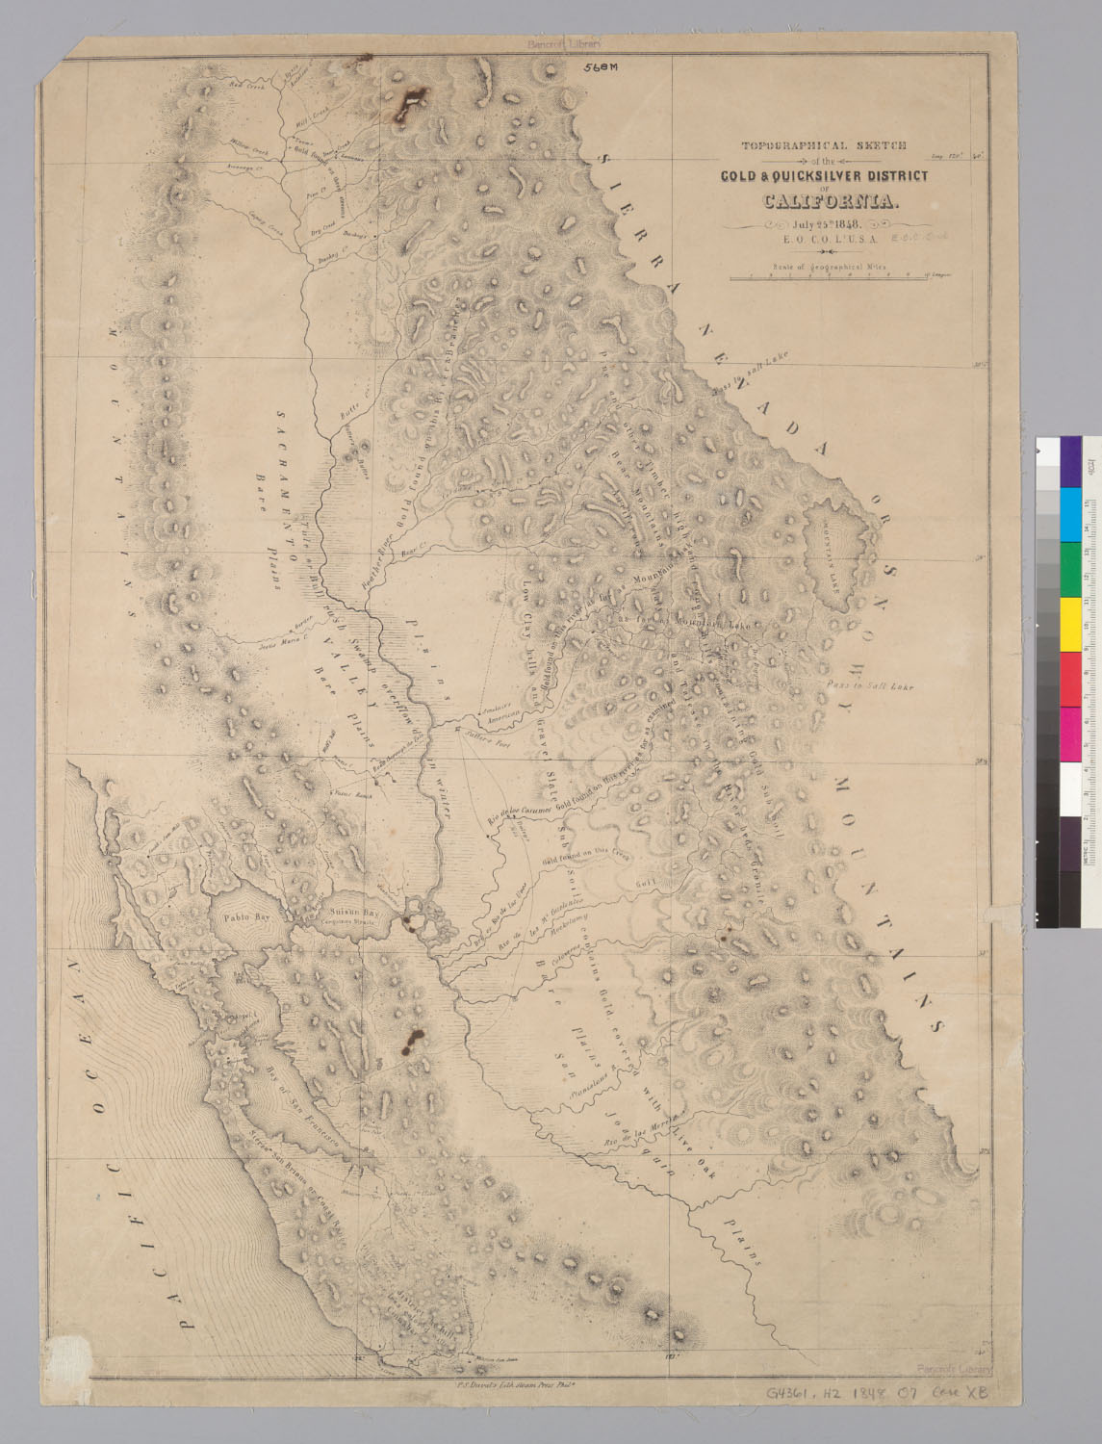
Gold and Quicksilver map FIRST "ACCURATE" MAP OF CALIFORNIA GOLD REGIONS 25 July1848

Slide 11
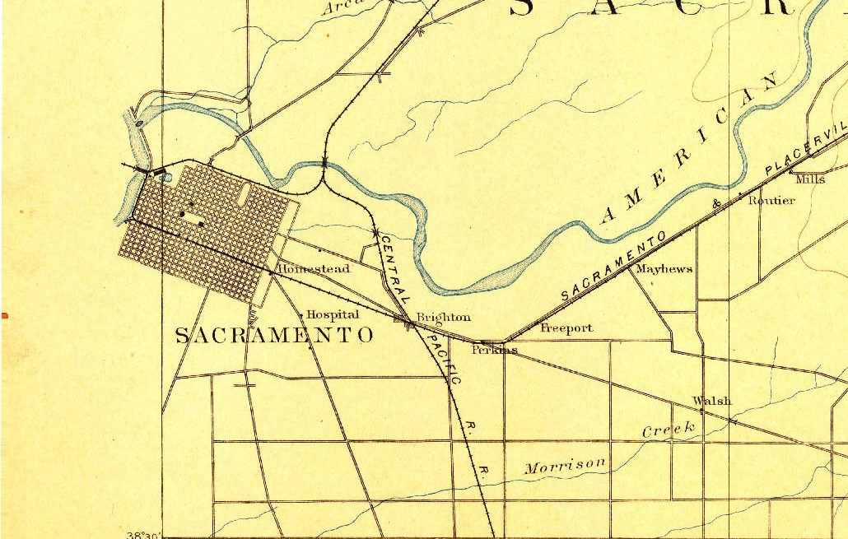
In the fall of 1848, Ord and Sherman, in the employ of John Augustus Sutter Jr., assisted Captain William H. Warner of the U.S. Army Corps of Engineers in the survey of Sacramento, California, helping to produce the map that established the future capital city's extensive downtown street grid.
1891 map
of Sacramento

Slide 12
Plan de la Cuidad De Los Angeles. Surveyed by E.O.C Ord, Lt. U.S.A. and Wm. R. Hutton, Asst., 29 Aug 1849

Slide 13
1850, January – sails for the East Coast by way of Panama
1850, Sept. 7 – returns to CA by way of Panama
1851-52 – as Capt., 3rd Artillery returns east to Ft. Independence, Massachusetts
1852-55 – Coast Survey Savannah, GA surveys Savannah river and then to San Pedro, CA

Slide 14
While stationed in California meets and courts Mary Mercer Thompson who is from a prominent SF family. They marry in S.F. in 1854 and have 13 children of whom 7 reach maturity. 1st child born in 1855, the last in 1874. 3 sons and 4 girls. Boys raised Catholic, girls Episcopalians.
She was the daughter of Judge Robert Augustine Thompson, member of Congress from Virginia and judge in the courts of California, and Mary Ann Smith Slaughter, a daughter of Captain Philip Slaughter and a granddaughter of James Slaughter. Colonel James Slaughter commanded a regiment at the first engagement of the Revolutionary war in Virginia.

Slide 15
By 1854 six of James and Rebecca Ord’s sons were in CA.
Ord’s brothers: Pacificus was a US District Atty in SF. James Lycurgus was a doctor in Monterey. Robert and John were farming near Sacramento. William Marcellus was assisting Edward on the Coast Survey.
In 1855 James and Rebecca with their daughter Georgiana left D.C. and went to CA. Soon Placidus brought his family to CA which completed the Ord family migration to CA.

Slide 16
1855 – Benicia, California
1855 – Yakima Expedition
1856 – Benicia, California
1856 – Rogue River Oregon Expedition; action of Macanootenay Village and Chetco river
1856-58 – Benicia, California
1858 – Ft. Miller, (San Joaquin valley, Madera County) California; frontier duty
1858 – Spokane Expedition; battles of Four Lakes and Spokane Plain, skirmish at Spokane River

Slide 17
1859 – Ft. Monroe, Virginia (Artillery School of Practice)
1859, 17 Oct – while attending artillery school at Fort Monroe, Virginia, Ord was summoned by Secretary of War John B. Floyd to quell John Brown's raid on the Harpers Ferry Federal arsenal.
However, Col. Robert E. Lee reached Harpers Ferry first, and Colonel Lee telegraphed Captain Ord that the situation was under control and Ord and his men would not be needed at Harpers Ferry. They were instructed to halt at Fort McHenry in Baltimore.
1859-60 – Ft. Monroe, Virginia

Slide 18
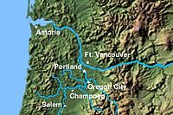
At the outbreak of the Civil War in April 1861, Ord was serving as Captain of Battery C, 3rd U.S. Artillery, and also as post commander at the U.S. Army's Fort Vancouver in Washington Territory.

Slide 19
Ft Vancouver 1859

Slide 21
Ord’s friend, Major Julius P. Garesche, Asst Adjutant General at Army HQ recommends Ord for promotion from Captain to Brigadier General.
1861, Sept. 14 – Appointed Brig. General of U.S. Volunteers - Pennsylvania (vast majority of the Union Army was United States Volunteers).
1861-62 – In command of a brigade of the Army of the Potomac.

Slide 22
1861, Dec. 20 – In command of troops at battle of Dranesville, Virginia (1st Union victory)
The Battle of Dranesville was a small battle during the American Civil War that took place between Confederate forces under Brigadier General J.E.B. Stuart and Union forces under Brigadier General Edward O. C. Ord on 20 December 1861, in Fairfax County, Virginia, as part of Major General George B. McClellan's operations in northern Virginia. The two forces on similar winter-time patrols encountered and engaged one another in the crossroads village of Dranesville. The battle resulted in a Union victory.
His fellow General John Reynolds is said to have remarked upon hearing of the Dranesville battle “Confound that fellow! I knew, if there was a fight to be scared up, Ord would find it.”

Slide 23
Battle of Dranesville, VA

Slide 24
1862, May-June – In command of a division in the Department of the Rappahannock
1862, May 2 – promoted to Major General, U.S. Volunteers
1862, June-Aug. – In command of 2nd Division at Corinth, Mississippi
1862, Aug.-Sept. – In Major General Grant's operations in Mississippi, commanding left wing of Army of the Tennessee
1862, Sept. 19 – Battle of Iuka, MS
1862, Sept.-Oct. – In command of the District of Jackson, Tennessee
1862, Oct. 5 – Battle of Hatchie, MS, severely wounded in ankle
1862-63 – While recovering from injuries part of Military Commission investigating Gen. Buell's Campaign in Kentucky and Tennessee
1863, June-Oct. – In command of 13th Army Corps, engaged in Siege of Vicksburg, capture of Jackson, MS

Slide 26
Minie ball

Slide 27
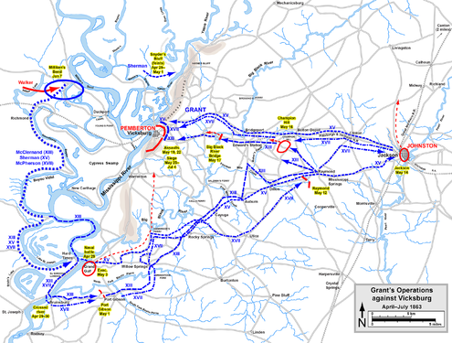
Ord commands XIII Corps during siege of Vicksburg

Slide 28
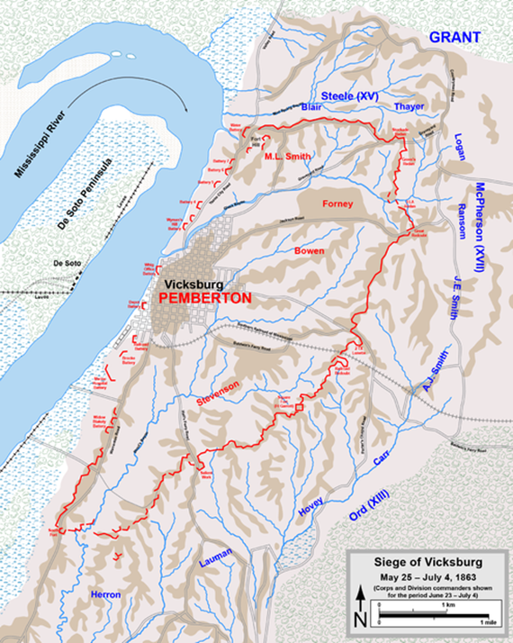

Slide 29
1864, Jan.-Feb. – Commanded 13th Army Corps in the Department of the Gulf (N.O.)
1864, April-July – Commanded troops in West Virginia
1864, July – Commanded 8th Army Corps and all troops in Middle Department
1864 July-Sept. – Commanded 18th Army Corps; in operations against Richmond; wounded (rt leg) in assault and capture of Ft. Harrison (Sept. 29)
1865, Feb. – Assumes command of Department of Virginia and Army of the James

Slide 30
The Incident – 26 March 1865
It was during this time the incident Ord never talked about, yet certainly never forgot took place. Ord's XVIII Corps was drawn up for a Presidential review in City Point (near Petersburg), VA. Lincoln arrived early and started the review with General Ord.
Carl Sandburg in his book, Abraham Lincoln – The War Years, Vol. VI, engagingly describes what happened next. Mrs. Lincoln and Mrs. Grant approached the review site in a jouncing, horse drawn ambulance. The first thing Mrs. Lincoln saw upon arriving was Mrs. Ord riding side saddle in the review. She happened to be riding quite close to the President.
Mrs. Lincoln immediately cried out in outrage: What does the woman mean riding by the side of the President and ahead of me? Does she suppose he wants her by the side of him?

Slide 31
Sandburg notes: She went into a frenzy that mingled extravagant rage and drab petulance.
Meanwhile Mrs. Ord seeing the ambulance arrive, rode over to join the ladies and found herself in the midst of an extraordinary tongue lashing. An observer notes: All that I could do was see that nothing worse occurred.
Major's Joke - Sandburg relates: A nephew of Secretary Seward, a young Major and a member of Ord's staff, a joker, rode alongside and blurted out with a rich grin: The President's horse is very gallant, Mrs. Lincoln. He insists on riding by the side of Mrs. Ord.
Mrs. Lincoln snapped, What do you mean by that? and young Major Seward at once had horse difficulties and shied away in a crazy gallop.

Slide 32
When the review had ended and the troops were moving toward the enemy picket lines and death and wounds – Mrs. Lincoln hurled vile names at Mrs. Ord and asked what she meant by following the President.
Enough of this sent Mrs. Ord into tears. Mrs. Lincoln stormed until she had spent her strength.
Another observer said everyone was shocked and horrified. No doubt that included Mrs. Ord. Yet she never talked of it.

Slide 33
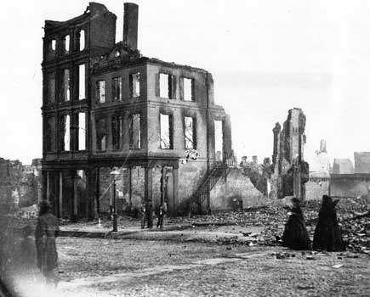
1865, Feb.-June – Commanded Department of Virginia; engaged in Siege of Petersburg, pursuit of Rebel Army to capitulation of Lee at Appomattox.
Defeated at the Battle of Five Forks on 1 April and forced to evacuate Petersburg the next day, General Lee then abandoned the Confederate capital of Richmond, Virginia, and retreated west, hoping to join up with some remaining Confederate forces in North Carolina. Union forces pursued the weary army, forcing the capture and surrender of 7,700 Confederates at Sailor’s Creek on 6 April. The remaining men marched west toward Lynchburg.
Battle of Appomattox Court House, (9 April 1865), one of the final battles of the American Civil War. It was here in Virginia, on the afternoon of 9 April, that Confederate General Robert E. Lee surrendered to Union General Ulysses S. Grant, setting the stage for the end of the four-year civil war.
Women in mourning among the ruins in a burned section of Richmond, Virginia, April 18 1865

Slide 34
Pursuit of Lee to Appomattox April 1865

Slide 35
Union General Philip H. Sheridan realized what Lee was doing and managed to intercept Lee’s army at Appomattox Court House, 25 miles east of Lynchburg, on 8 April, capturing his supplies and obstructing his route west. At dawn the next morning, the Confederate II Corps attacked Sheridan’s cavalry and broke through to the ridge behind them. But there they saw the vast numbers of Union infantry from the Army of the James (Gen Ord), arriving after an all-night march and lining up for battle. In the face of such overwhelming numbers, Lee accepted the inevitable and asked Grant for a ceasefire. Grant offered to meet Lee wherever he chose.
Lee’s aide surveyed the small village of Appomattox Court House and found a brick house belonging to Wilmer McLean. There, around 4:00pm on 9 April 1865, Lee surrendered. His men were allowed to return home with their horses and mules after handing in their arms. Attempts to continue Confederate resistance on other fronts soon failed. It was the end of the American Civil War.

Slide 36
The McLean House, in Appomattox Court House, was where General Robert E. Lee surrendered to General Ulysses S. Grant to end the American Civil War.

Slide 37
“The Table”
Catherine Weider states the following from cousin Jimmy Ord regarding Molly Ord - 30 Sep 2000
A final intriguing story about Molly, only part of which is in the Cresap notes.
Following the capitulation of the Confederate Forces at Appomattox, General Ord purchased for $40 from Mr. McLean the table on which General Lee signed the terms of surrender.
Per the Cresap notes, it was said that Mrs. Ord sold it to a Chicago collector named Gunther for $1,000 after the General's death had left her large family with insufficient means.
The Chicago Historical Society came into possession of the table when it purchased Gunther's entire collection. And now, of course, the Society believes it owns the original table.

Slide 38
But my father's cousin, Eleanor Preston Ritchie, has a version of events that complicates this view. According to her story, Mrs. Ord had a number of copies made of that historic piece of furniture which she sold to various parties. The number I have heard most frequently is 5. I have spoken to the curator in charge of the Ord collection at the Smithsonian about the matter - he says the museum has always believed that the table it got from the Ord's is the original.
The curator admits, however, that the McLean house in Appomattox also thinks it has the original. And he was amused to learn that there is a table in the study in which I now sit that has been passed down though my line of the family as the original.
The curator said that the only way to figure out which is the original is to get all the tables in the same room for examination by an expert.
Didn't Molly manufacture a wonderful puzzle for all of us?

Slide 39
14 April 1865
The last message Pres Lincoln read regarding the Civil War was one sent to him by Gen Ord. It was received by Lincoln in the Presidential Box at Ford’s Theater shortly after 10pm.
At about 10:30pm Lincoln is assassinated by John Wilkes Booth.
Early next morning Gen Ord receives a telegram alerting him to the President’s assassination.
Grant orders Ord to arrest a number of Southerners. Ord questions this order. Grant later withdraws this order. It is Ord’s belief the assassination was done by an “insane Brutus with but few accomplices”.

Slide 40
1865-66 – Commanded Department of the Ohio – In August of 1866 he is promoted to Brigadier General in the regular Army and a breveted Major General. 1 Sept. Mustered out of Volunteer Service
1866-67 – Commanded Department of the Arkansas – deals with Reconstruction and other issues
1867-68 – Commanded: Fourth Military District (Arkansas and Mississippi)
1868-71 – Commanded: Department of California – finds SF full of “smallpox and mud”. His forces pursue Apache Indians in Arizona.
1871-75 – Commanded: Department of the Platte (Nebraska) – security of the Union Pacific Railroad and settlers becomes a primary concern for him. Also deals with grasshoppers who ravaged the territory. Provided aid to those who were its victims.

Slide 41
In January 1872, Ord was a member of the Bison hunting excursion with the Grand Duke Alexei Alexandrovich of Russia on the plains of southwest Nebraska with American celebrities of the day.
They included Philip Sheridan (second in command of the United States Army), Lt. Col. George Armstrong Custer, Buffalo Bill Cody, Wild Bill Hickock, and Texas Jack Omohundro (American frontier scout, actor, and cowboy).
1875-80 Commanded: Department of Texas – deals with cross border raids by revolutionaries, bandits, cattle rustlers
Eldest daughter Roberta marries Mexican General Geronimo Trevino on 20 July 1880 in San Antonio
1881, Jan. 28 placed on the retired list as Major General, US Army
At this time, General Sherman wrote of him, “He has had all the hard knocks of service, and never was on soft or fancy duty.”
Becomes an agent for the Southern Pacific Railroad and Standard Oil in Mexico

Slide 42
Later in 1881, Ord was hired by his former commander, U.S. Grant, president of the Mexican Southern Railroad, owned by Jay Gould, as a civil engineer to build a railroad line from Texas to Mexico City.
In July 1883, unhappy with his pay, he boards a steamer in Vera Cruz to return to New York City.
Contracts Yellow Fever en route to Havana. Dies ashore in Havana on 22 July 1883.
Out west in Fort Missoula, MT, General Sherman is notified. He wrote “As his intimate associate since boyhood, the General here bears testimony of him that a more unselfish, manly and patriotic person never lived.”
Gen Ord is first buried at Oak Hill Cemetery in D.C. and in 1900 moved to Arlington National Cemetery where he lies today.

Slide 43
Mrs. E.O.C. Ord who died in 1894, is buried in a quiet corner of San Antonio's National Cemetery. She was a gentlewoman by all accounts, lovely, gracious and a crack horsewoman.
Proof of her gentility might be that she held her composure until the very end of one of the most brutal tongue lashings on record – delivered by the wife of President Abraham Lincoln.

Slide 44
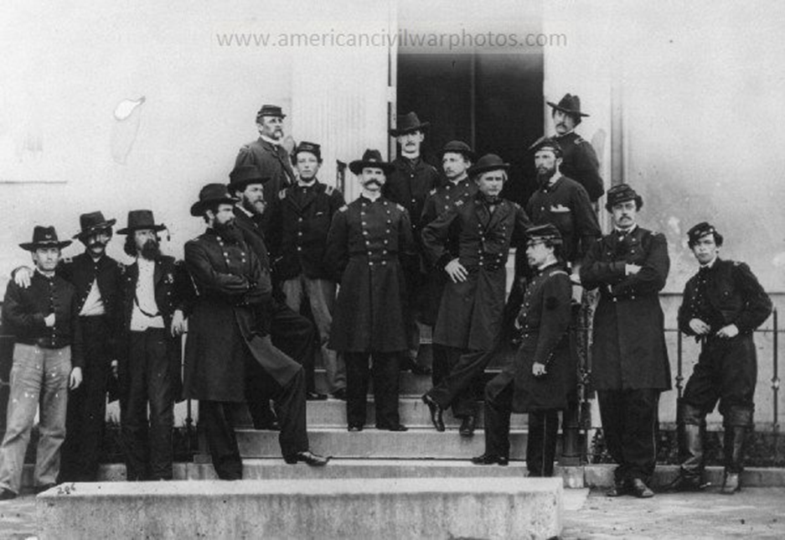
Maj. Gen. E.O.C. Ord and staff on the South Portico of the White House of the Confederacy in 1865, Library of Congress
MG Ord and Staff

Slide 45
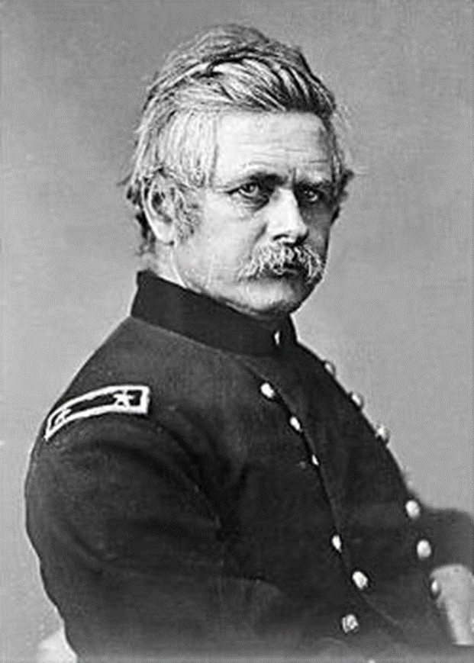
Ord at Confederate White House, Richmond, VA
April 1865 − Note the table
MG Ord

Slide 46
EOC Ord Photos − Mary and daughter Roberta at Confederate White House, Richmond, VA April 1865
Note the table

Slide 47
E.O.C. Ord at Vicksburg, MS

Slide 48
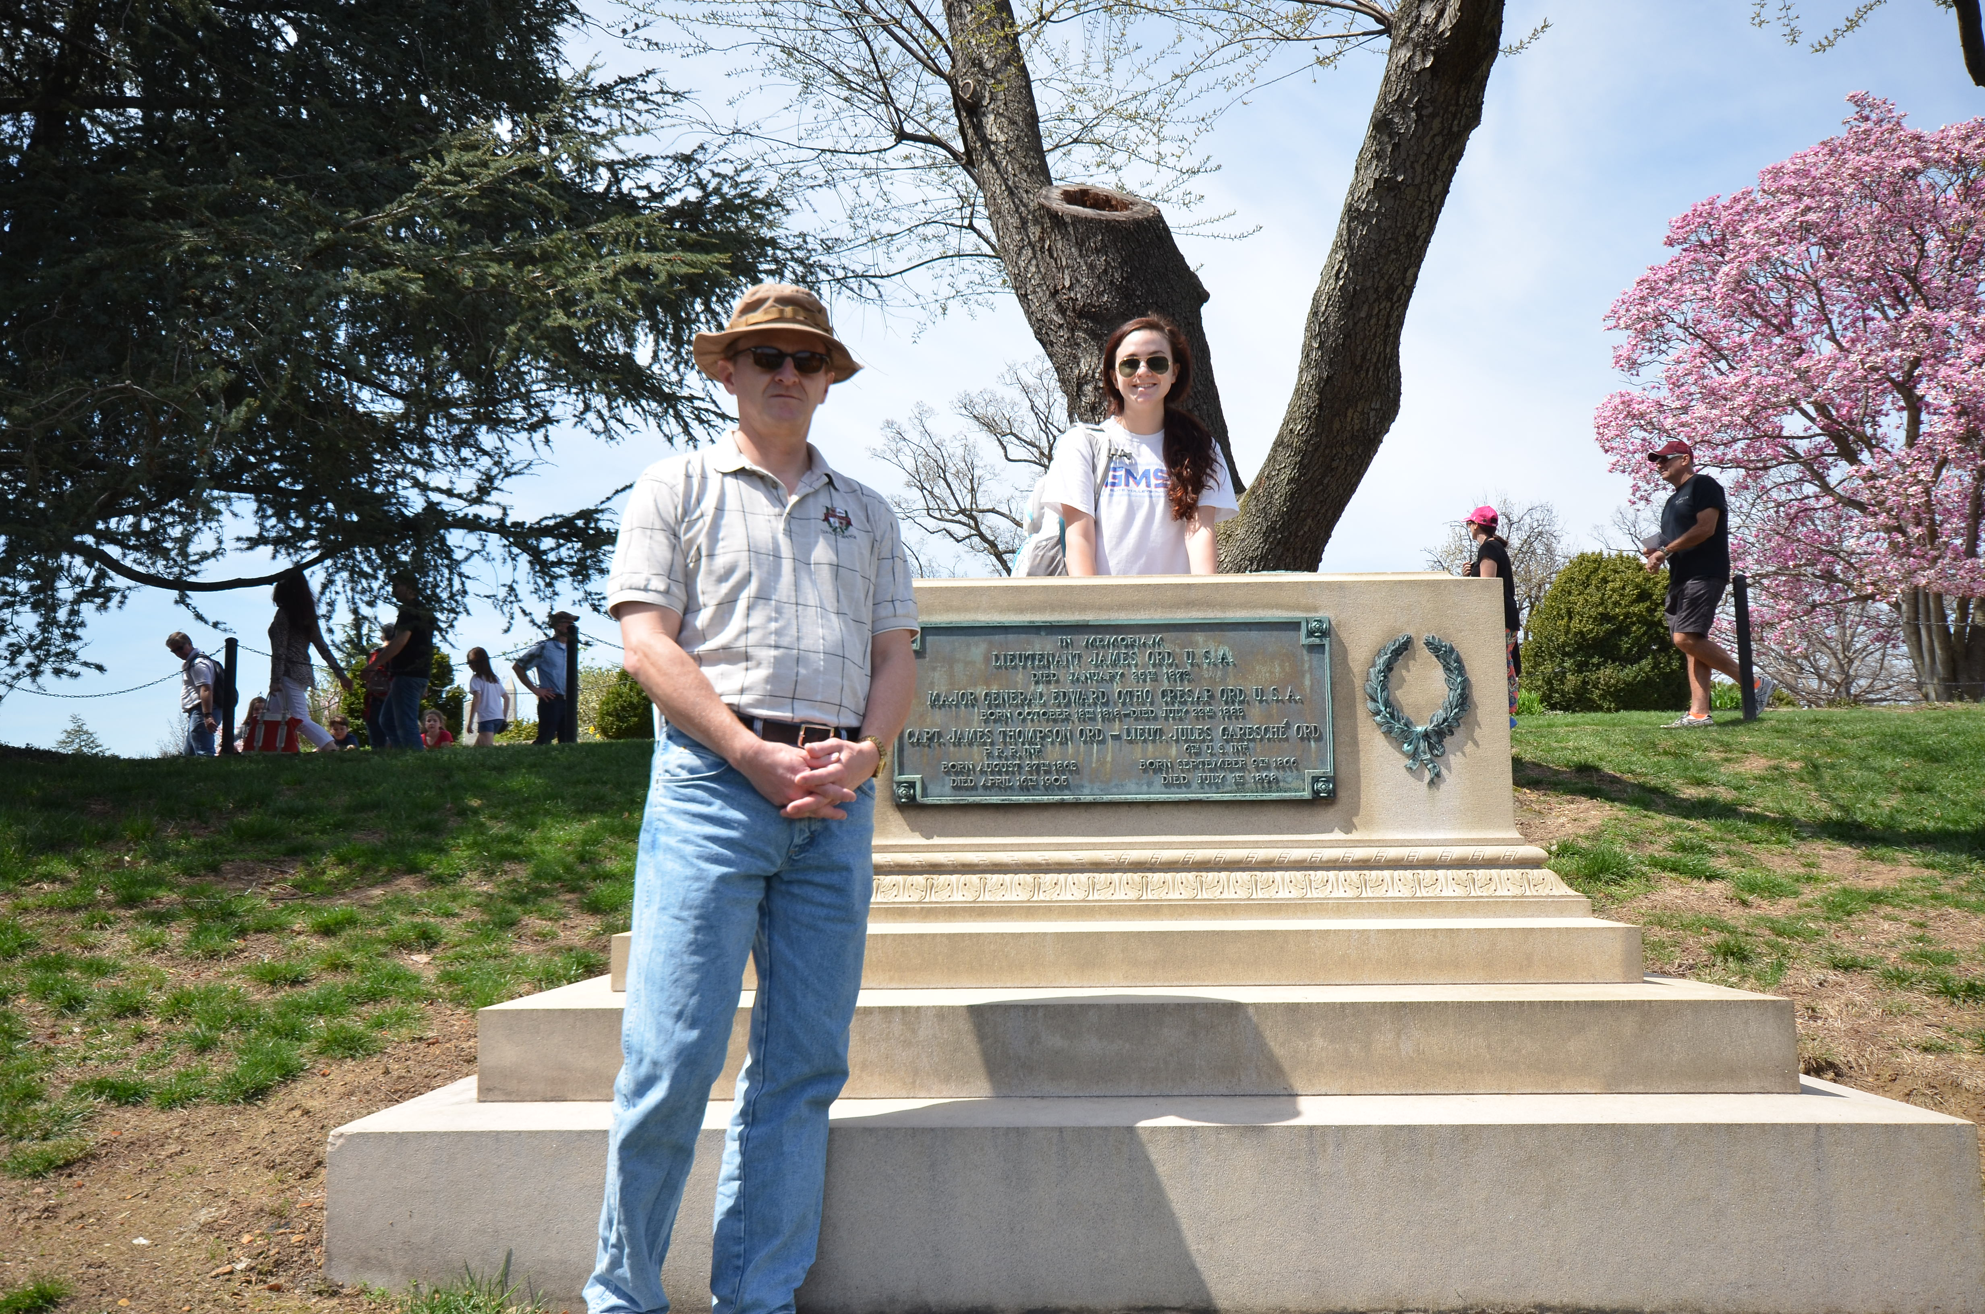
Sarah and me
at Ord gravesite
Arlington National
Cemetery
April 2014

Slide 49
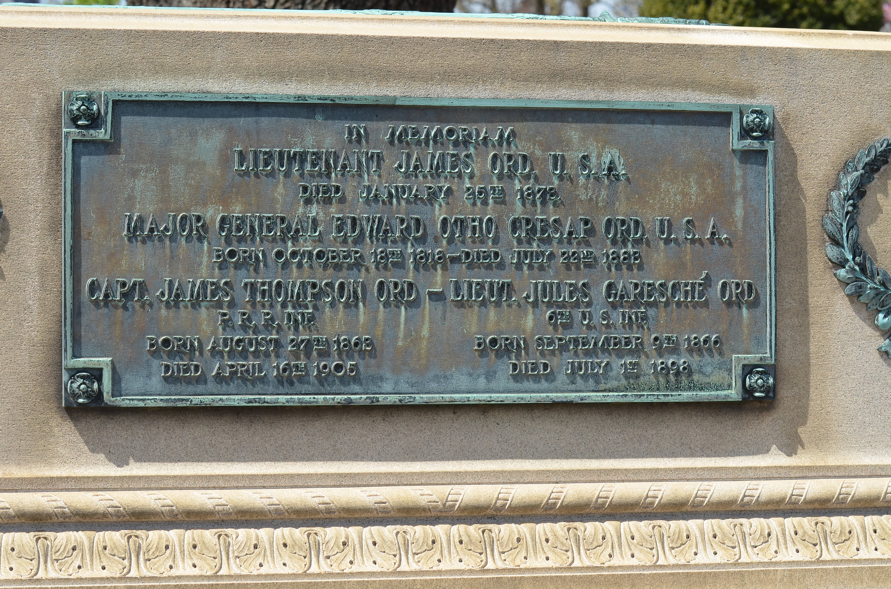

Slide 50
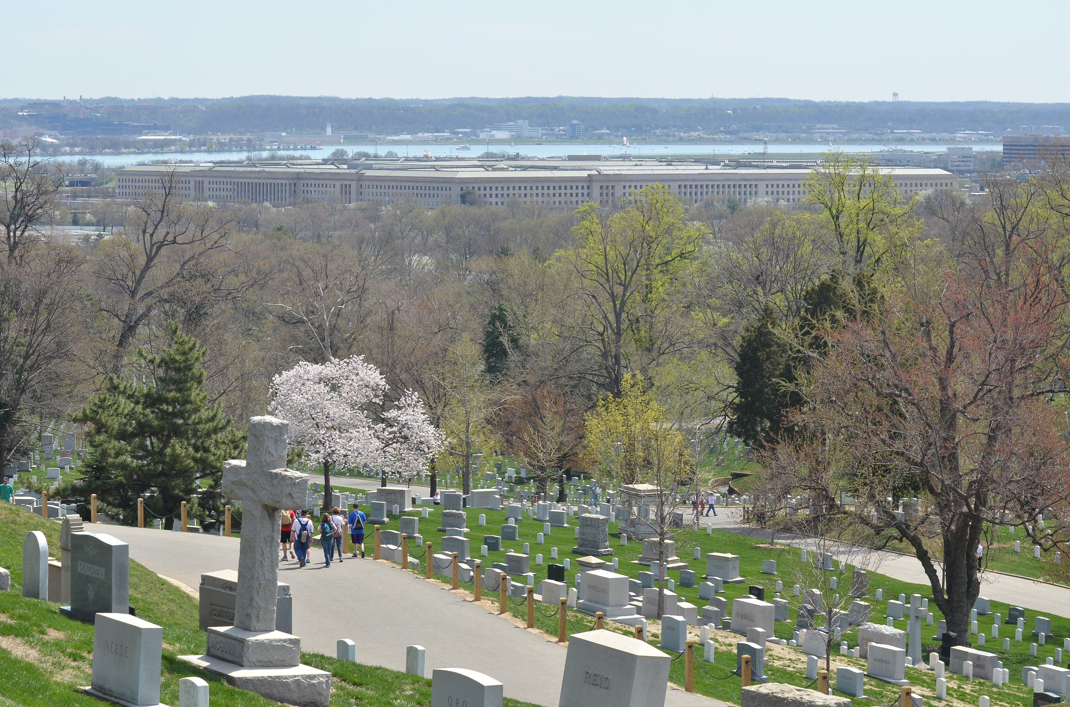

Slide 51
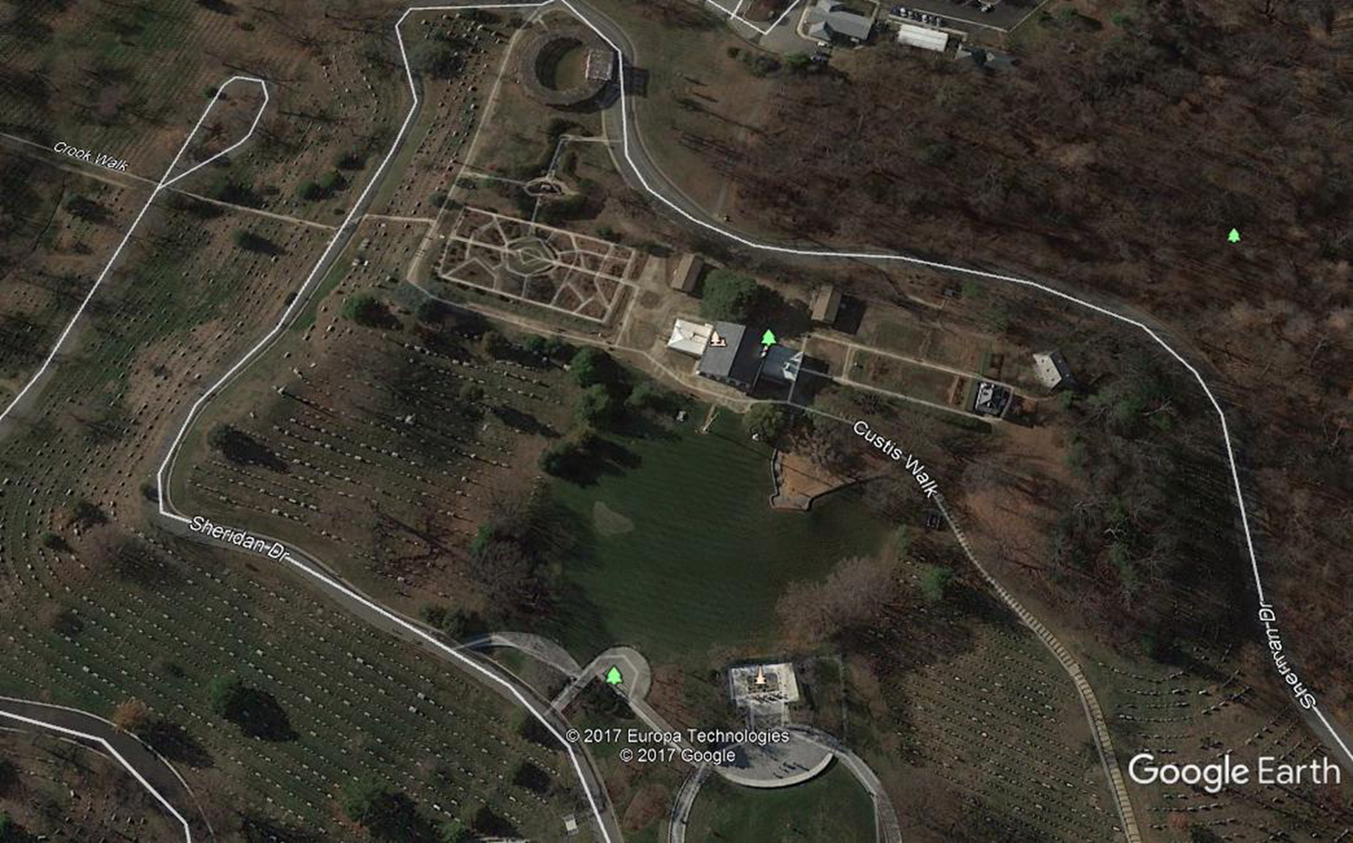

Slide 52
Some locations named for EOC Ord
Ord Streets in S.F., Monterey, LA, Highland, Newberry Springs, CA
West Ord Way, Anaheim, CA
Ord Way, Westminster, CA
Ord Mountain Rd, Lucerne Valley, CA
Ord View Rd, Apple Valley, CA
Ord Mountain, CA
Ft. Ord, CA
Ord Bend (SPRR station) near Ord Ranch(Colusa County), CA
Ord Mountain, TX
Ord, NE
Mt. Ord, AZ
Ord Street, D.C.
There is a bust of Ord at Grant's Tomb in New York City depicting him as one of five sentinels (Sherman, Thomas, McPherson, Sheridan, and Ord) watching over the tomb of President Ulysses S. Grant.

